Slide 1
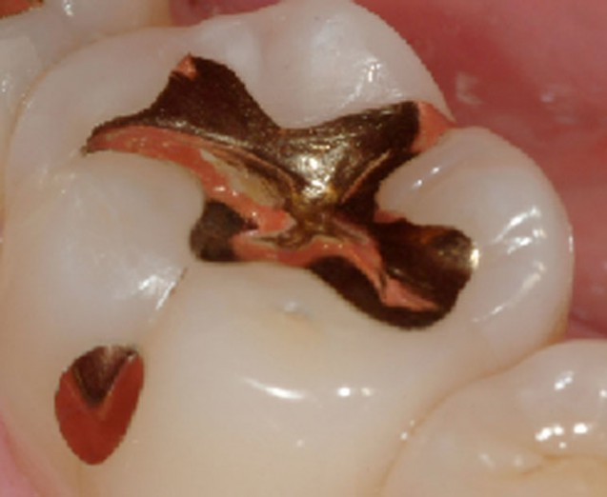
Direct filling gold: cavity design and compaction methods

Slide 2

Introduction
Gold foil was one of the earliest materials available for restoration of teeth.
It is undeniably the most permanent restorative modality. Though the term 'gold foil' and 'direct filling gold' have been used interchangeably, gold foil is one form of pure gold used for direct restorations.

Slide 3
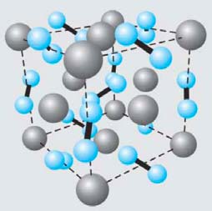
Properties of pure gold
Pure gold is soft, malleable, ductile and does not oxidize under the normal atmospheric conditions.
It is rich yellow in colour with a strong metallic lustre.
Fuses at a temperature of 1063°c and boils at 2200°c.
The true density of pure gold is 19.0-19.3 g/cm³.
Brinell's hardness number of pure gold is 25.
3

Slide 4
Properties of pure gold
6. Tensile strength is105 Mpa
7. Compressive strength is 295 Mpa
8. The yield strength rises from 0 to 30,000 psi.
9. Coefficient of thermal expansion (C.T.E.) is 14.4 x 10⁻⁶ /ºc.
10. It has a high thermal conductivity of 0.710 cal/sec/cm² (ºc/cm).
11. Gold is the noblest of all metals. Air or water at any temperature does not affect or tarnish gold.
4

Slide 5
Properties of pure gold
11. Small amounts of impurities have a pronounced effect on mechanical properties of gold
e.g. 0.2%. lead makes gold very brittle.
12. Most important property of pure gold which permits its use as a filling material is the ability to be cold worked and welded at room temperature.
5

Slide 6
Advantages
1. A permanent- method for repairing teeth, and the restoration can last as long as the tooth itself.
2. A noble metal hence does not tarnish and corrode in the oral cavity.
3. Insoluble and has a coefficient of thermal expansion close to that of tooth.
4. The cavity preparation when kept ideally small is atraumatic to the dental pulp and supporting structures.
6

Slide 7
Advantages
5. The surface can be effectively polished and reducing the chances of plaque accumulation.
6. Pure gold is ductile and hence can be burnished to produce an accurate margin for the restoration.
7. The density and hardness of compacted gold enables the restoration to withstand compressive forces sufficiently.
7

Slide 8
Disadvantages
1. Unesthetic
2. Expensive
3. Long chairside time required for restoration
4. Use limited to conservative cavities
5. High thermal conductivity
6. Technique sensitive
7. High condensation forces
8

Slide 9
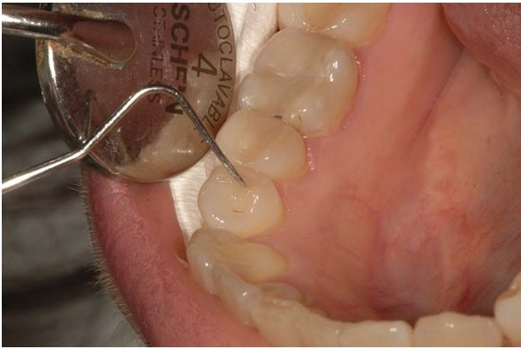
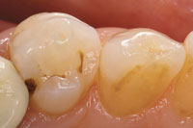
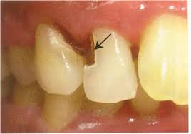
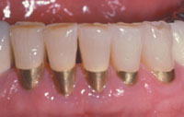
Indications
1.Incipient carious lesions:
Class I lesions in premolar teeth
Class II lesions on premolar teeth
Class III lesions in maxillary and mandibular anterior teeth.
Class V gingival lesions:
Indicated for small lesions on the facial surfaces of premolars and canines and occasionally on the mandibular incisors.
9

Slide 10
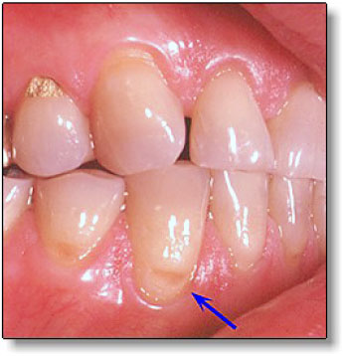
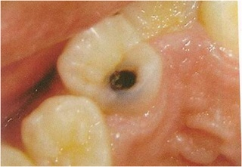
Indications
2. Erosion areas
3. Atypical lesions:
Proximal lesions on teeth adjacent to crown preparations.
Vent holes in crowns and defective inlay crown margins can be effectively repaired with direct gold.
Class VI lesions (cusps tips) and incisal edges.
Retrograde root canal filling material.

Slide 11
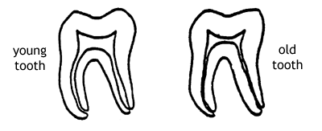
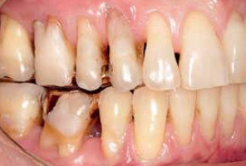
Contraindications
1. Teeth with very large pulp chambers
2. Severely periodontally weakened teeth
3. Large carious lesions
4.Handicapped, elderly or young patients
5. Psychologically unsound patients
6. When economics is a limiting factor

Slide 12
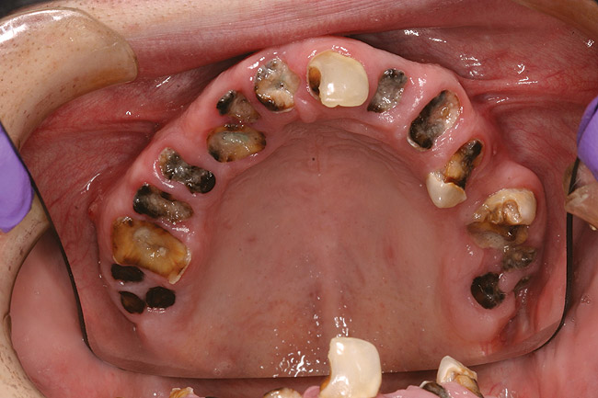
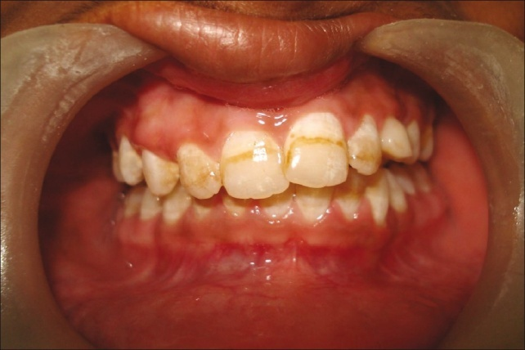
Contraindications
7. Where esthetics is a prime requirement.
8. Inaccessible/poorly accessible areas.
9. Isolation unobtainable.
10. Areas of undesirable occlusal stresses.
11. Patients with a high caries index.
12. Hypoplastic areas.

Slide 13
Types of direct filling gold
The different forms of direct gold available are:
I. Foil
Sheets
Pellets (hand-rolled and commercially rolled)
Cylinders (preformed and hand-rolled)
Ropes
Corrugated foil/ Carbonized gold foil
Platinized foil
Laminated foil

Slide 14
Types of direct filling gold
II. Electrolytic precipitated gold
Mat gold/crystal gold
Mat foil
Gold calcium alloy/Electralloy
III. Powdered gold
Goldent

Slide 15
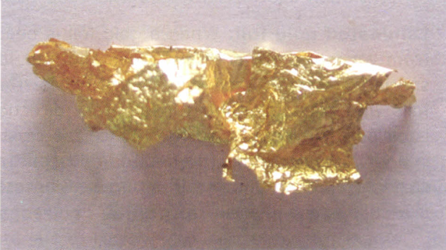
Types of direct filling gold
A. Gold foil
The pure metal is first melted and formed into ingots of desired size.
The numbering system refers to the weight of the sheet used, so it reflects the thickness as well i.e:
No.3 gold foil - weighs 3 grains (0.194 gm) -0.38 mm thick
No.2 gold foil - weighs 2 grains (0.130 gm) -0.25 mm thick

Slide 16
Types of direct filling gold
B.Gold foil pellets
An ideal pellet is produced from a No.4 gold foil by the dentist or his assistant.
Pellet sizes may vary from 1/2 -1/128.
C.Gold foil cylinders
This form can also be both hand rolled and commercially rolled.
It is custom made by rolling cut segments of No.4 gold foil.

Slide 17
Types of direct filling gold
D. Corrugated gold foil/Carbonized gold foil
Manufactured by placing thin sheets of paper in between the gold foil sheets, which are then ignited.
E. Platinized gold foil
This is a sandwich of gold and platinum.
1. Pure platinum foil is sandwiched between two sheets of gold foil.
2. Layers of platinum and gold are rolled over together.

Slide 18
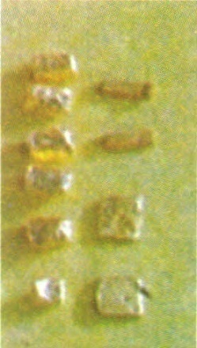
Types of direct filling gold
F. Laminated gold foil
It is a combination of 2-3 foils is known as laminated gold foil which makes it more resistant to the applied forces.
II. Electrolytic precipitated gold
It is crystalline gold powder formed by electrolytic precipitation.
Mat gold/crystal gold
These are available in the form of strips of
Medium widths (2.0 mm) and
Wide widths (3.0 mm).

Slide 19
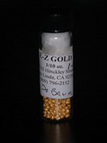
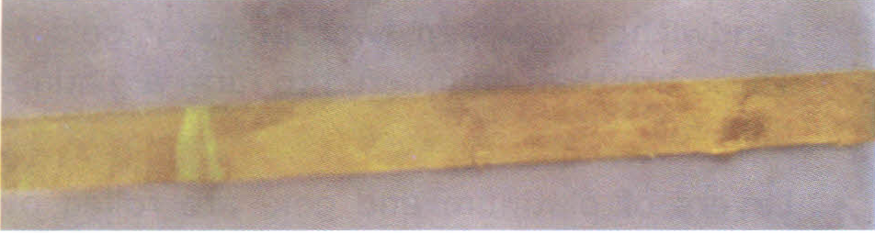
Types of direct filling gold
Mat foil-This is a sandwich of mat gold placed in sheets of No.3/No. 4 gold foil.
Electralloy -This is an alloy of electrolytic gold and calcium.
The calcium content is usually 0.1-0.5% by weight.
III. Powdered gold- Powdered gold is in the form of minute particles.
The average particle size is 15µ.
Commercially available pellets of powdered gold wrapped in a gold foil are known as 'Goldent'

Slide 20
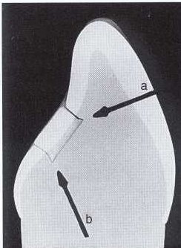
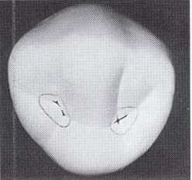
Tooth preparation for direct gold restorations
Fundamentals of tooth preparation
The margins in outline form must not be ragged.
They are established on sound areas of the tooth
The outline must include all structural defects
The marginal outline must be designed to be esthetically pleasing, because the final restoration may be visible.

Slide 21
Tooth preparation for direct gold restorations
Resistance form is established by orienting preparation walls to support the integrity of the tooth, such as a pulpal wall that is flat and perpendicular to occlusal forces.
All enamel must be supported by sound dentin.
Optimally placed axial or pulpal walls promote the integrity of the restored tooth, thus providing a suitable thickness of remaining dentin.

Slide 22
Tooth preparation for direct gold restorations
Retention form is established by parallelism of some walls and by strategically placed converging walls.
In addition, walls must be smooth and flat where possible and internal line angles must be sharp (to resist movement).
Internal form includes an initial depth into dentin, ranging from
Class I preparations 0.5 mm from the DEJ
Class V preparations0.75mm from cementum

Slide 23
Tooth preparation for direct gold restorations
Optimal convenience form requires suitable access and a dry field provided by the rubber dam.
Access may additionally require the use of
A gingival retractor for class V restorations
A separator to provide a minimal amount of separation (0.5 mm) between anterior teeth for Class III restorations.

Slide 24
Tooth preparation for direct gold restorations
Class I cavity preparation:
The external form of the cavity for direct filling gold is quite similar to that of silver amalgam.
The outline form is extended to include all the carious lesion and fissured enamel.
In case of a pit defect, the outline may be simply triangular, oblong or circular.

Slide 25
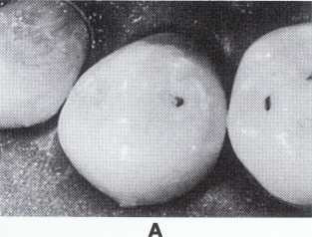
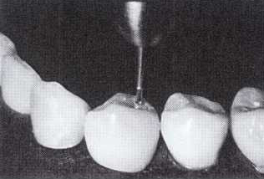
Tooth preparation for direct gold restorations
The carious lesion is entered with a No.1 round bur and the outline form established with an No. 330 pear-shaped bur.
Walls of the preparation are made parallel to each other.
In wide cavities, mesial and distal walls need to be diverged slightly towards the occlusal surface.
Pulpal floor is made flat and perpendicular to the occlusal forces.
Retention is provided by the parallelism of walls and sharp line angles and point angles.

Slide 26
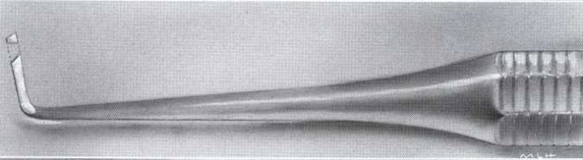
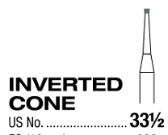
Tooth preparation for direct gold restorations
Accentuation of the angles is done with a No. 6 ½ -2 ½ -9 hoe.
Additional retention if desired is given in the form of undercuts in dentin by a
No. 33 ½ inverted cone bur or
No. 6 ½ -2 ½ -9 or 8-4-10 hoe.

Slide 27
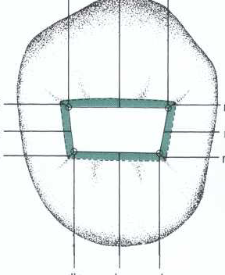
Tooth preparation for direct gold restorations
These retention grooves are placed facially and lingually in the occlusal preparation of posterior teeth at the faciopulpal and linguopulpal line angles respectively.
For the lingual surfaces of anterior teeth and facial surfaces of molars, these are given incisally and gingivally on incisoaxial and gingivoaxial line angles respectively.

Slide 28
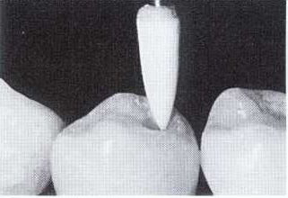
Tooth preparation for direct gold restorations
Any remaining infected carious dentin is removed with a large No.2 round bur.
Planing of the walls is done with a No. 6½-2½-9 or 8-4-10 hoe.
A very slight cavosurface bevel of 30-40° and 0.2 mm in width is placed on all the margins using a smooth finishing bur or a flame shaped whitestone.

Slide 29
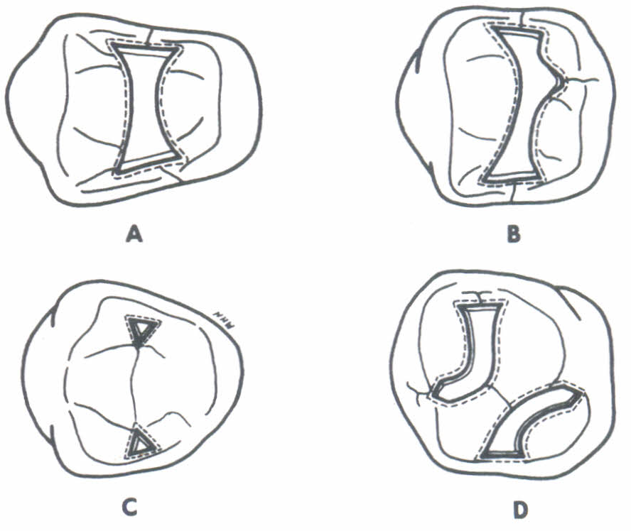
Tooth preparation for direct gold restorations
A. Simple Class I in molars and pre-molars occlusal surface
I. General shape : The outline is similar to Class 1cavity preparations for amalgam, but with three modifications:-
a. These preparations have angular corners.
b. The extensions in the facial and lingual grooves in molars will end in a pointed termination, rather than rounded.
c. The outline form of the cavity preparation is less pronounced.

Slide 30
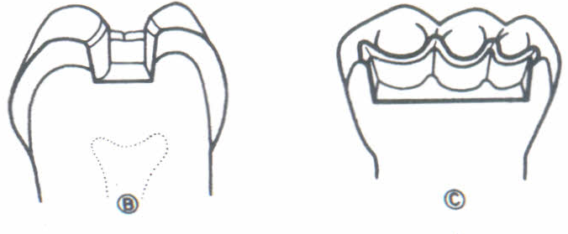
Tooth preparation for direct gold restorations
Internal anatomy
Internal features very similar to those found in amalgam class I with two exceptions:
a. The line and point angles are definite and very angular in dentin substance.
b. The cavosurface margins should be bevelled at 45° to the direction of the enamel rods and should include at least 1/4th of the enamel wall.

Slide 31
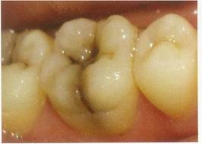
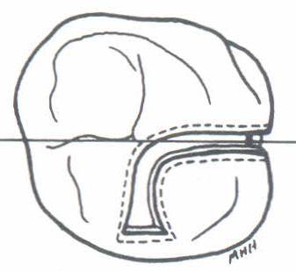
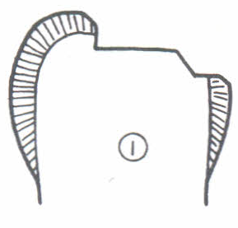
Tooth preparation for direct gold restorations
B. Compound or complex Class I cavity preparations
These are Class I cavity preparations with facial and/or lingual extensions.
They will have the same shape, occ1usally,as the simple design.
The facial and/or lingual extensions will be parallelogram in shape.
The mesiodistal width of the facial and lingual portions of the cavity preparation should be very limited.

Slide 32
Tooth preparation for direct gold restorations
Simple Class I cavity preparations on the lingual surface of upper anterior teeth and at the facial and lingual pit areas of upper and lower molars
The general shape of this type cavity will be triangular.
The internal anatomy will include a flat axial wall surrounding walls in three planes, i.e
An internal, undercut
A straight second plane formed of enamel and dentin,
A third plane which is the partial bevel.

Slide 33
Tooth preparation for direct gold restorations
II. Class II Cavity Preparation
The outline form is similar in size and shape to the preparation for amalgam.
The occlusal portion is similar to the class I cavity
The tooth on the occlusal surface is entered with a No. 1 or 2 round bur and the cavity form extended with a No. 169 tapering fissure.

Slide 34
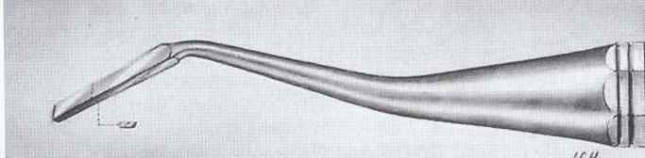
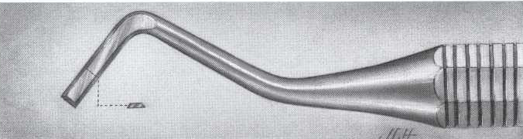
Tooth preparation for direct gold restorations
The proximal box is placed in dentin and is in the form of a cone.
The width of the proximal box at the gingival portion is slightly greater than at the occlusal portion.
All the walls of the proximal box are extended minimally.
The proximal walls are finally cut and planed with
Maxillary preparations a no. 10-7-8 biangled chisel
Mandibular preparations no.10-7-14 hatchet

Slide 35
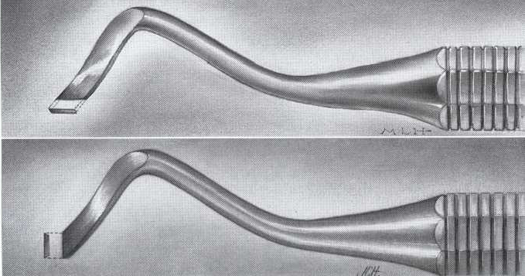
Tooth preparation for direct gold restorations
A No. 33½ inverted cone bur establishes a flat gingival wall and a 10-4-8 hoe smoothens the pulpal and gingival floors.
Retention is provided by sharp line angles and point angles.
These angles are accentuated with No. 10-80-8-14 and 10-95-8-14 gingival marginal trimmers.

Slide 36
Tooth preparation for direct gold restorations
There are three designs for Class II cavity preparations for direct gold materials.
The conventional design
The conservative design
The simple design

Slide 37
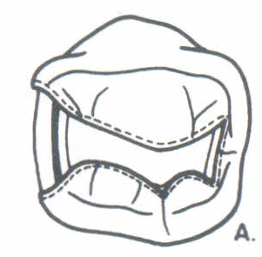
Tooth preparation for direct gold restorations
Conventional design
The occlusal outline is similar to simple Class I cavity preparation in molars and premolars.
The isthmus portion will definitely have a reverse S-shaped outline.
The proximal portion will be a one-sided inverted truncated cone.
The width of the cavity will not exceed 1/5th of the intercuspal distance.

Slide 38
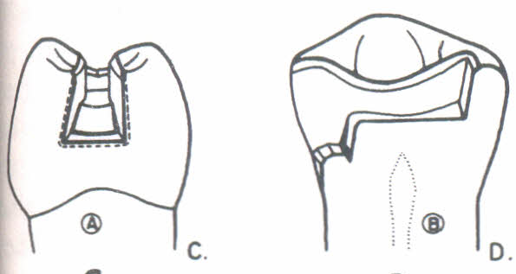
Tooth preparation for direct gold restorations
The margins gingivally will just clear the contact area.
Facial and lingual margins should only include the contact area.
Internal anatomy
All line angles, with the exception of the axio-pulpal, are sharp.

Slide 39
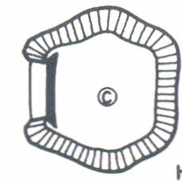
Tooth preparation for direct gold restorations
The facial and lingual walls may each have four planes:
The first one being an inner, dentinal plane making a very sharp and acute angle with the axial wall
The second plane is formed completely of dentin
The third plane is an enamel-dentinal plane following the direction of the enamel rods
The fourth plane is completely in enamel wall.

Slide 40
Tooth preparation for direct gold restorations
B. The conservative design
The gingival floor is in four planes:
An internal, reverse-bevel plane
A transitional plane, formed completely of dentin and slightly flat
An outer, enamel dentinal plane following the direction of the enamel rods.
A partial bevel on enamel only, not to include more than 1/4 of its extent.

Slide 41
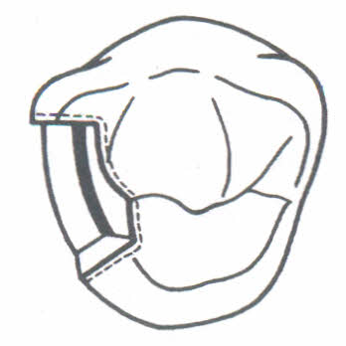
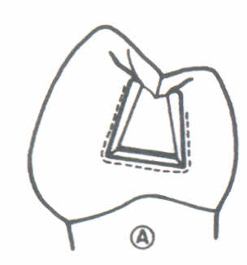
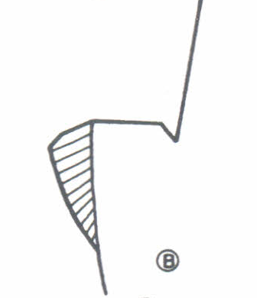
Tooth preparation for direct gold restorations

Slide 42
Tooth preparation for direct gold restorations
III.Simple design
Internal anatomy
An occluso-gingival cross-section show that the occlusal wall is formed of three planes
One plane, in the form of dentin, at right angle to the axial wall
second plane inclining occlusal proximally, and formed of enamel and dentin.
Third one in the enamel wall, in the form of a bevel.

Slide 43
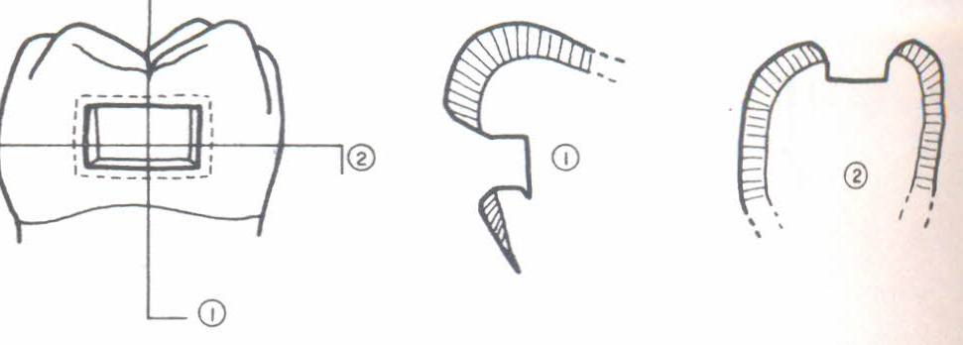
Tooth preparation for direct gold restorations

Slide 44
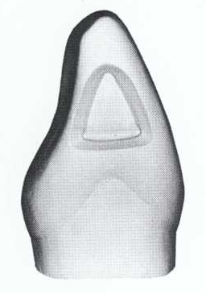
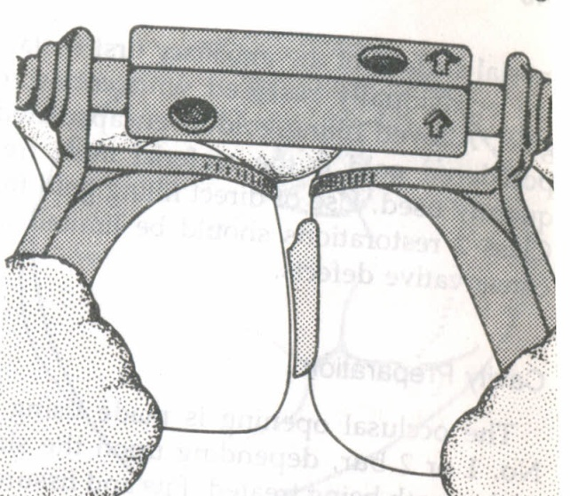
Tooth preparation for direct gold restorations
Class III Cavity Preparations
There are three basic designs for Class III cavity preparations to accommodate direct gold materials.
Each is subjected to a number of modifications according to access, esthetics, and remaining tooth structure.
This will enable creation of two (three) planed labial and lingual walls and a pronounced boxed incisal retention form within a definite incisal wall.

Slide 45
Tooth preparation for direct gold restorations
1. Cavity design by Ferrier
The general outline form is roughly triangular in shape.
With a No. 1 round bur, the carious lesion is approached from the facial surface.
A No. 33½ inverted cone bur is used to extend the marginal outline form.
End of the bur establishes the lingual wall using incisogingival strokes

Slide 46
Tooth preparation for direct gold restorations
End of the bur creates the gingival wall by moving it labiolingually.
The side of the bur can be used in incisogingival direction to form the facial wall.
When viewed proximofacially, the facial outline follows the buccal contour of the tooth and meets the gingival margin in a slight obtuse angle.

Slide 47
Tooth preparation for direct gold restorations
Gingival margin is straight facio-lingually and placed beneath the free gingiva if possible.
It meets the facial margin in a slight obtuse angle and the lingual margin in a slight acute angle.
Lingual margin is straight in its gingival 2/3rd and then curves abruptly in the incisal 1/3rd to meet the incisal angle
The axial wall extends 0.5 mm into dentin.

Slide 48
Tooth preparation for direct gold restorations
Resistance form is created by this flat axial wall, and slight divergence of the buccal and lingual walls.
Retention is provided by an acute axio-gingival line angle and an incisal undercut placed into dentin directed facio-incisally.
Small angle formers are used to sharpen the linguo-axio-gingival and facioaxio-gingival point angles and for creating the acute axio-gingivalline angle.

Slide 49
Tooth preparation for direct gold restorations
Final finishing involves planing all the preparation walls.
A small hoe (6½-2½-9) is used for lingual and gingival walls, an angle former for the facial wall.
Planing of the cavosurface margins done with a wedelstedt chisel.
A bevel is placed on all the enamel margins by wedelstedt chisel.

Slide 50
Tooth preparation for direct gold restorations

Slide 51
Tooth preparation for direct gold restorations
2. Loma Linda Design
The cavity preparation under this design is made with a lingual access.
It is therefore best indicated in
where esthetics is the major concern
where the carious involve the lingual marginal ridge.
Restoration of these cavities is primarily done with powdered gold and gold foil veneer.

Slide 52
Tooth preparation for direct gold restorations
Using a 1/2 round bur, the carious lesion is entered from the lingual surface
The base of a 33½ inverted cone bur is used to establish the labial and gingival walls using incisogingival and labiolingual strokes respectively.
Side of the same 33½ bur helps in creating the lingual wall.
Outline of this cavity design is triangular with rounded corners.
Facial outline is extended only minimally.

Slide 53
Tooth preparation for direct gold restorations
Retention is provided by grooves in three opposing directions using a No. ½ round bur to drill into the dentin.
Incisal undercut is placed in an inciso-labio-axial direction.
The other two grooves in the form of a cylinder (1.0-1.5 mm deep) are given on the gingival wall
The other retentive points at the facio-axio-gingival point angle.

Slide 54
Tooth preparation for direct gold restorations

Slide 55
Tooth preparation for direct gold restorations
3. Ingraham design
This cavity design is indicated primarily for the incipient proximal lesions in anterior teeth where esthetics is the major concern.
Maintenance of oral hygiene and low caries and plaque indices are essential requirements when using this design.
The general form of the cavity is parallelogram in shape.

Slide 56
Tooth preparation for direct gold restorations
Labial margin is placed within the contact area so that its not visible externally.
The gingival margin clears the contact area
Incisal margin is also limited to within the contact area.
The lingual margin extends on to the lingual surface to provide access for instrumentation.

Slide 57
Tooth preparation for direct gold restorations
Axial wall is flat, forms a right angle to the labial wall
Retention grooves are placed on the inciso-axial and gingivoaxial line angles such that their depth decreases towards the lingual surface.
This would mean that the undercuts are deeper towards the labial position of the line angle compared to the lingual portions.

Slide 58
Tooth preparation for direct gold restorations
The carious lesion is entered with a No. 1 round bur from the lingual access.
No. 168 bur is moved labially, inciso-gingivally and axially to remove tooth structure in the proposed outline.
The incisal and gingival walls are planed with a hatchet.
Incisal and gingival retention grooves are cut at the expense of incisal and gingival walls respectively with an inverted cone bur.

Slide 59
Tooth preparation for direct gold restorations

Slide 60
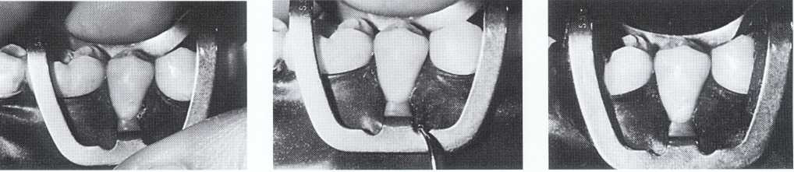
Tooth preparation for direct gold restorations
CLASS V CAVITY
The use of rubber dam is necessary to provide adequate isolation.
Access is facilitated by employing a no. 212 retainer or gingival retractor (developed by dr. W.I. Ferrier).
The hole for the tooth to be treated is punched 1 mm facial to the actual position.

Slide 61
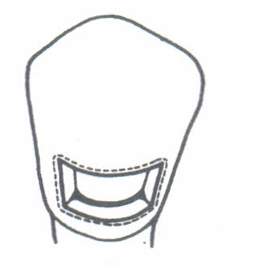
Tooth preparation for direct gold restorations
Preparation design
The most commonly followed class V cavity design is the Ferrier's design.
External outline is trapezoidal in form.
Preparation is begun using a No. 33½ inverted cone bur
The same bur is used to establish the occlusal,
gingival, mesial, distal and axial walls.

Slide 62
Tooth preparation for direct gold restorations
The end of the bur forms the distal wall and the side forms the occlusal, mesial and gingival walls.
Occlusally, the margin is straight and parallel to the occlusal plane
The gingival margin is straight and parallel to the occlusal plane but shorter than the occlusal margin.
The gingival margin is placed below the free margin of gingiva.

Slide 63
Tooth preparation for direct gold restorations
End of the bur establishes the axial depth in dentin
The depth of the axial wall in occlusal half of the preparation is approximately 1.0 mm and in the gingival half is 0.75 mm.
The axial wall is straight occluso-gingivally and parallel to the facial surface of the tooth.
Mesio-distally it has a slight curvature to prevents encroachment on the pulp.

Slide 64
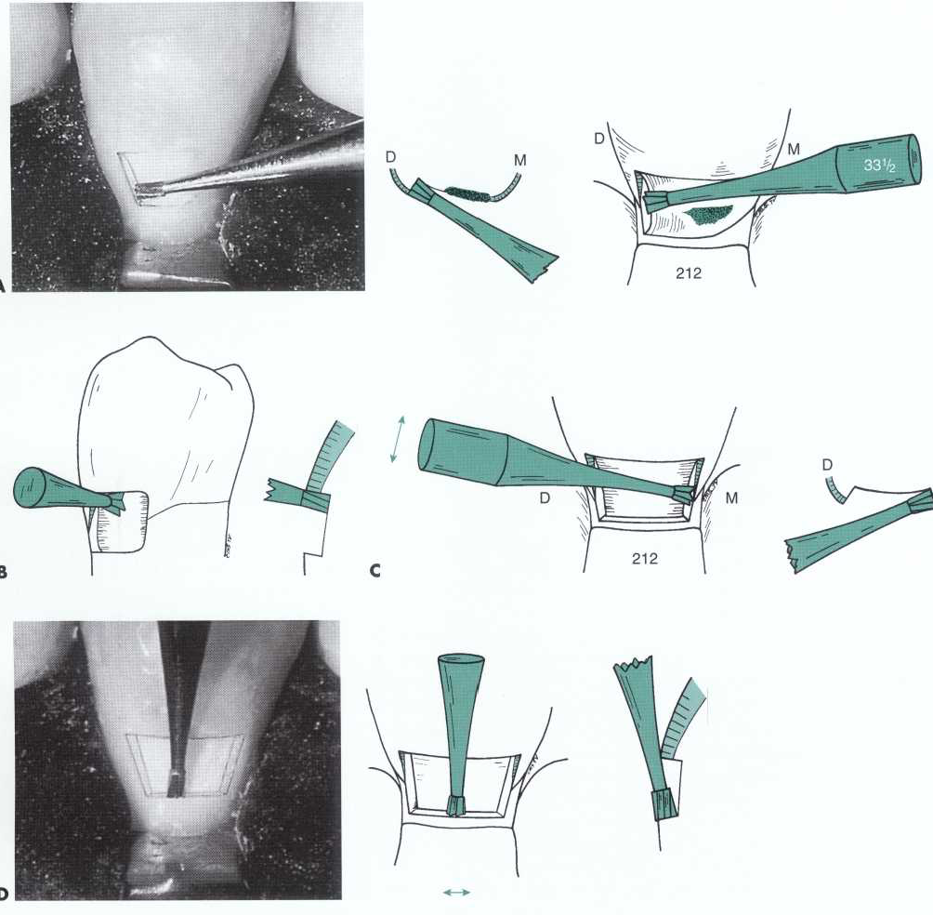
Tooth preparation for direct gold restorations

Slide 65
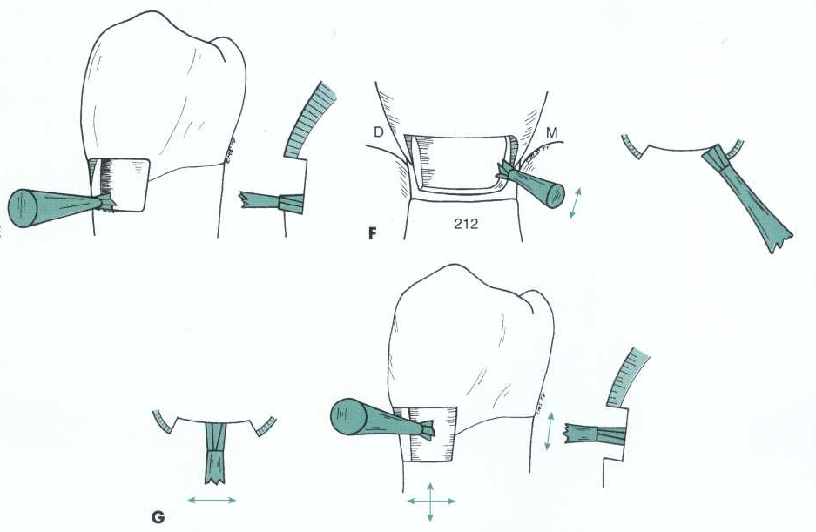
Tooth preparation for direct gold restorations

Slide 66
Tooth preparation for direct gold restorations
The divergence of mesial and distal walls towards the surface prevents undermining the enamel.
The acute axiogingival line angle is the key to retentive feature.
Its prepared with a No. 6½-2½-9 hoe working from cavosurface to the axial wall in a push stroke.

Slide 67
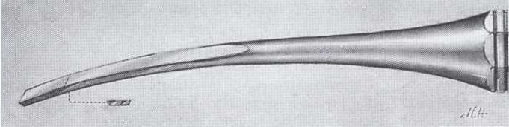
Tooth preparation for direct gold restorations
Planing the mesial, distal and gingival walls is done with a No. 6½-2½-9 hoe or 10-4-8 (larger hoe).
Occlusal margin and the axial wall are planned using a wedel stedt chisel.
A slight cavosurface bevel is given using a wedelstedt chisel.
A bevel on the gingival wall is not given when the latter extends to the cementum

Slide 68
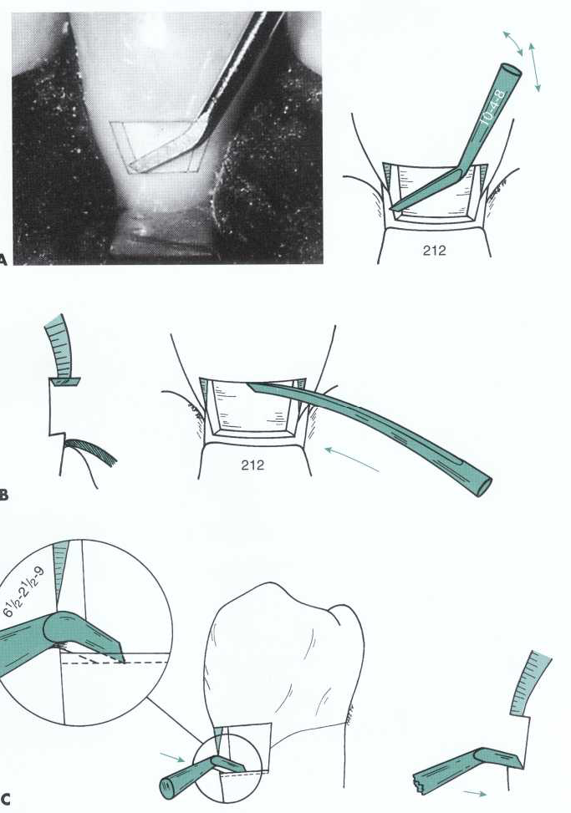
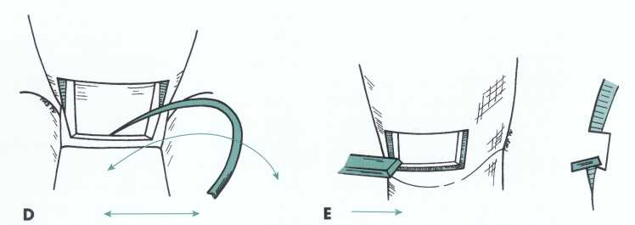
Tooth preparation for direct gold restorations

Slide 69
Tooth preparation for direct gold restorations
Variations in design

Slide 70
Degassing and annealing
Annealing a gold foil refers to the removal of surface contaminants.
'Degassing' or 'desorption' is the preferred term over 'annealing' because at no stage is any recrystallization or stress relief intentional.
The primary purpose is to produce an atomically clean surface and render the material cohesive and workable.

Slide 71
Degassing and annealing
Annealing can take place in three successive stages:
Recovery,
Recrystallization
Grain growth.

Slide 72
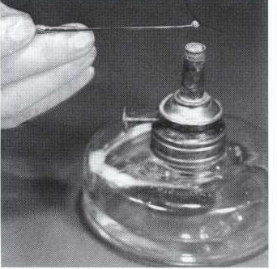
Degassing and annealing
Degassing can be accomplished in one of three ways:
A. By an open alcohol flame
Absolute 90% of ethyl or methyl alcohol without any additives used to produce a clean blue flame
With this method it is important to use the middle zone of the flame (the high energy reducing zone).
Each piece of gold is held in such a zone for three to five seconds before inserting it into the cavity preparation

Slide 73
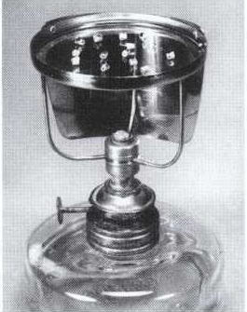
Degassing and annealing
B.A mica over a flame
A sheet of mica can be used over any type of flame.
Divide the surface of the mica into several areas to indicate the time the pieces of gold were put on the mica.
Maximally, five minutes are allowed for any piece of gold to be heated on the mica.

Slide 74

Degassing and annealing
C. Electric degassing
This is the most controlled and standardized way of decontaminating gold materials
Maximally, five minutes are allowed for any piece to be kept in the electric decontaminator.
The gold is heated at temperature of
850ºF for 10 min.

Slide 75
Degassing and annealing
There are certain hazards from overheating
The recrystallization and grain growth.
The possible incorporation of impurities
Gold materials that are supplied in a sintered form.
The complete melting of the surface of the gold.
During mass decontamination of direct gold

Slide 76
Steps of direct filling gold restoration
Building of restoration
Paving of restoration
Compaction of restoration
Finishing of restoration:
• Burnishing
• Contouring
• Polishing
• Final burnishing.

Slide 77
Steps of direct filling gold restoration
Building of Restoration
Gold is placed in the preparation in the form of three step build up
1. Tie formation
2. Wall Banking
3. Formation of shoulder
Paving of Restoration
Excess is built up is done to allow for restoration of normal contour and a smooth surface.

Slide 78



Steps of direct filling gold restoration
Tie formation
banking of walls
Shoulder formation

Slide 79
Condensation/compaction of the direct filling gold
The objectives of compaction are:
I. Cohere two pieces of gold to each other.
2. Adapt the gold intimately to the walls and margins of the prepared cavity.
3. Cold work and thus harden the gold mass to increase its strength.
4. To drive away air from in between the pieces of gold and gold-tooth interface.

Slide 80
Condensation/compaction of the direct filling gold
Modes of condensation
l. Hand instrument condensation:
The condensation energy produced by this method is not always sufficient to fulfill the objectives of condensation.
It can be used only as a first step in a two-step condensation

Slide 81

Condensation/compaction of the direct filling gold
2. Pneumatic condensation
It involves the use of vibrating condensers
Controlling the air pressure allows adjustments in the frequency and amplitude of the condensation strokes.
Although an efficient way, this is not completely controllable

Slide 82

Condensation/compaction of the direct filling gold
3. Electronic condensation
This is the most efficient and controlled way of condensing direct gold materials.
The vibrating condenser heads can have an intensity or amplitude from 2 oz to15 lbs and a frequency of 360 to 3600 cycles/min.
The typical apparatus easily permits control of such variables.

Slide 83

Condensation/compaction of the direct filling gold
4. Hand condenser and mallet
Although this is the oldest way of condensing direct gold materials, it is still being used.
It requires a trained assistant to apply the condensation energy with the mallet.

Slide 84
Condensation/compaction of the direct filling gold
Gold condensers
Direct gold condensers have one common feature of their faces are serrated with pyramidal shaped configurations.
1. Increase the surface area of the condenser face
2. Act as swaggers help in fulfilling the objectives of condensation.
3. Establish some triangular indentations in the condensed piece of gold, so that the succeeding increment of gold may be interlocked and immobilized in these indentations

Slide 85

Condensation/compaction of the direct filling gold
Condensers for direct gold restorations are provided in different shapes:
Round condensers (the bayonet condenser ) - are used mainly to start the direct gold restorations and to establish "ties" in the inner parts of restorations.
Parallelogram and hatchet condensers are used for preliminary condensation and to create the bulk of the restorations.

Slide 86
Condensation/compaction of the direct filling gold
Compaction technique
In compaction of the gold, most important factors are
Direction of force
Amount of force
Pattern of application of the compacting force.
Direction:
Compacting force should be such that it takes the advantage of property of gold to flow under pressure.
Black advocated an angle of 45º to cavity walls at periphery such that line of force bisect the line angles and trisect the point angles.

Slide 87
Condensation/compaction of the direct filling gold
Amount of force:
The average force required to condense gold with condenser point of 1mm diameter is15 pounds.
Different types of condenser nibs are available like
Round (0.4 to 0.55 mm in diameter)
Parallelogram shaped (0.5 x 1 mm).
Rectangular(l x 1.3 mm)
Shank of the condenser can be straight, curved, monoangled.

Slide 88
Condensation/compaction of the direct filling gold
Under the constant malleting force if the nib area is small, greater pressure is applied per square cm, because area of a circle is directly proportional to the square of the diameter
If the diameter of the nib is doubled, the compaction force per square cm is decreased by four times.

Slide 89
Condensation/compaction of the direct filling gold
Pattern of using force:
It is important to step the condenser in a controlled pattern
It has been seen that overlapping, one-half the diameter of the working end produces the finest restoration.
This results in uniform compaction and a dense mass, optimal flow of metal, and sealing of preparation walls.
A gold piece is placed in the initiating point which is generally in the corner of the preparation

Slide 90

Condensation/compaction of the direct filling gold
Malleting is started using the condenser in the center of the mass.
Force of condensation should be 45° to preparation walls.
To the already condensed gold, force of condensation should be 90 degrees, this prevents the displacement of already condensed goldpieces.
Condensation is done with rocking motion of the instrument from the plane, perpendicular to the plane of the wall

Slide 91

Condensation/compaction of the direct filling gold
During condensation, as the condenser is moved towards periphery, each succeeding step of the condenser should overlap the half of the previous step. This is called as "stepping“.
In spite of careful compaction, some void spaces may occur in the compacted gold and along the preparation walls. This is called bridging.

Slide 92
Condensation/compaction of the direct filling gold
Condensation of gold foil
Gold foil has enough toughness even in thin sections.
Because of this it can be easily manipulated in smaller cavity preparations and against preparation bevels.
One difficulty encountered during its initial placement roll out of material in the undercuts towards the condenser.

Slide 93
Condensation/compaction of the direct filling gold
Condensation of mat gold
Mat gold is cut to the shape and size of the cavity and placed on the pulpal/axial walls of the preparation.
It condensed against the walls as a gold blanket using two condensers.One condenser stabilizes the gold while the other performs condensation.
Mat gold is easy to start with because of their loose spongy nature and hence is known as 'starter gold'

Slide 94

Condensation/compaction of the direct filling gold
Condensation of powdered gold
The cavity preparation for powdered gold differs slightly in two ways
(1) It does not require sharp line angles and point angles
(2) Flares and bevels in the cavity need to be minimized
These have a distinct clinical advantage during compaction because of their initial spreading quality.

Slide 95
Finishing of restoration
Burnishing
The first step in finishing of the gold restoration is burnishing.
A specially designed Spratley burnisher is moved with pressure over the restoration to close the void.
Contouring
Since there is excess of restoration built up to allow normal contour, this excess restoration is removed with very sharp knives, files and abrasive stones
Marginal excess can be removed using gold foil carver

Slide 96
Finishing of restoration
Polishing
The fine garnet disks and cuttle disks are moved from the metal to the tooth for final finishing.
To prevent the temperature elevation in the restoration, one must use lubricants and air coolants.
For polishing, silica, pumice or metallic oxide compounds can be used.

Slide 97
Finishing of restoration
Final Burnishing
Final burnishing is done to make the surface of the restoration shiny smooth free of voids.

Slide 98
Finishing of restoration
Advantages of finishing and polishing
Polished restorations do not tarnish or corrode in oral fluids
They promote the health of the gingival tissue which is in contact with the restoration
Polished restoration minimizes reflection of the light rays and creates a more esthetic and harmonious end result.

Slide 99
Conclusion
Direct filling gold still remains one of the most conservative and long lasting restorations in dentistry. Well placed direct gold restorations provide excellent service to patients for life time.
However the use of this material is on the decline in the present times because of its high cost, lack of technical expertise and the ever increasing demand for esthetic restorations.

